Slide 1
CAPP PLAN MONTHLY UPDATE
2018 Pinwheels for Prevention
Campaign
WEBINAR 1
Tuesday – 2/13/18
9:30am – 10:30am EST
WEBINAR 2
Friday – 2/23/18
10:00am – 11:00am EST

Slide 2
AGENDA
Welcome
2018 Pinwheels for Prevention Campaign
Comments/Questions
Adjourn

Slide 3
EVENTS and ACTIVITIES CHILD ABUSE PREVENTION MONTH
www.PreventChildAbuseFlorida.org

Slide 4
EVENTS and ACTIVITIES CHILD ABUSE PREVENTION MONTH
Events – please share your events to be listed on the Pinwheels for Prevention map
Proclamations – if you would like copies for your local events, email Jessica Collins at:
Jessica.Collins@eog.myflorida.com
Please provide the name and address,
and number of copies

Slide 5
2018 CAP MONTH #Pinwheel #Greatchildhoods

Slide 6
PINWHEELS FOR PREVENTION IS A NATIONAL CAMPAIGN
The strength of our NATIONAL campaign lies in consistent use of a few core elements.
National consistency and local creative flexibility are key for our campaign to have MAXIMUM COLLECTIVE IMPACT!

Slide 7
CORE CAMPAIGN ELEMENTS
Consistent use of the Pinwheels for Prevention campaign name
Consistent use of the official Pinwheels for Prevention campaign logo
Consistent use of campaign messaging
Use of the national pinwheel

Slide 8
HOW TO SPREAD THE WORD
Please see the “Toolkit” for examples of:
Media
Press Release
Proclamation
Letter to the Editor
Opinion Editorial
www.ounce.org/CAP_toolkit.html

Slide 9
HOW TO SPREAD THE WORD
“Toolkit” continued:
Pinwheel Displays, Banners and Yard Signs
Talking Points
Social Media Hashtags for this year are:
#Pinwheel #Greatchildhoods
www.ounce.org/CAP_toolkit.html

Slide 10
HOW TO SPREAD THE WORD
Use “social math” to make the numbers more meaningful to the audience.
Feature compelling stories of people who have found ways to make a difference.
Talk about the importance of healthy child development.
www.ounce.org/CAP_toolkit.html

Slide 11
HOW TO SPREAD THE WORD
Give specific examples of actions individuals, businesses and other can take to prevent abuse/neglect
See “10 Things you can do to prevent Abuse/Neglect” at: www.ounce.org/CAP_toolkit.html
Equate pinwheels with positive messages of ensuring nurturing relationships and healthy home environments.
www.ounce.org/CAP_toolkit.html

Slide 12
FLORIDA FOCUS
Florida’s First Lady Hosts Kickoff at the Governor’s Mansion on April 3rd
Pinwheel Facebook Photo Contest: Prizes for Most Creative, and Best Events in a large and small market!
Prizes will be awarded in May!
www.facebook.com/PreventChildAbuseFlorida

Slide 13
FLORIDA FOCUS
We will also focus on “Social Norms” and feature four (4) short films for sharing on social media.
These will be posted on our Facebook Page when completed.
www.facebook.com/PreventChildAbuseFlorida

Slide 14
FLORIDA FOCUS
Wear BLUE Day
April 6, 2018
www.facebook.com/PreventChildAbuseFlorida

Slide 16
EVENTS and ACTIVITIES CHILD ABUSE PREVENTION MONTH
Educate the community on the negative impacts of Adverse Childhood Experiences, and on building protective factors to become resilient to life’s stressors!
Contact Chris Lolley to set up your screening:
Clolley@ounce.org
850-933-3271

Slide 17
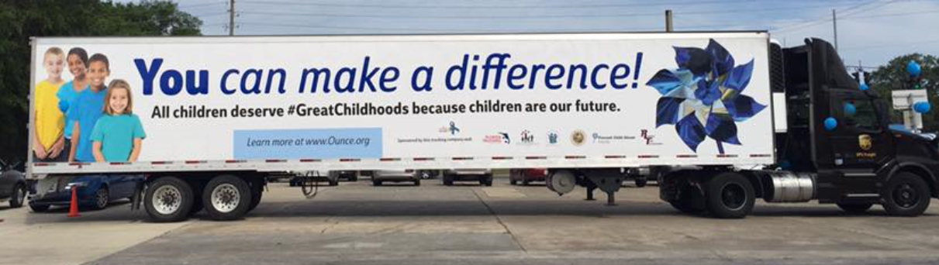
FLORIDA FOCUS
2018 Pinwheels for Prevention Truck Tour is (almost) fully booked!
Contact Chris for dates available
See the complete list of Truck Tour Stops at:
www.ounce.org/capevents.asp

Slide 18
WANT MORE INFO?
www.PreventChildAbuseFlorida.org
www.facebook.com/PreventChildAbuseFlorida
Chris Lolley
Cell: 850-933-3271
CLolley@ounce.org
Nydia Ntouda
850-921-4494, ext. 202
NNtouda@ounce.org
Jennifer Hartshorne
850-921-4494, ext. 202
JHartshorne@ounce.org

