Slide 1

Engaging and Retaining Substance-Involved Families

Slide 2

Increase awareness and understanding of the complexity of substance use disorders (SUDs) and potential impact on parenting
Identify signs of substance misuse
Enhance ability to successfully engage and retain participants and their families in home visiting programs
Further develop supervisory skills necessary to support home visitors working with substance-involved families

Slide 3

Hiding in Plain Site:
The Complexities of Substance Use Disorders

Slide 4

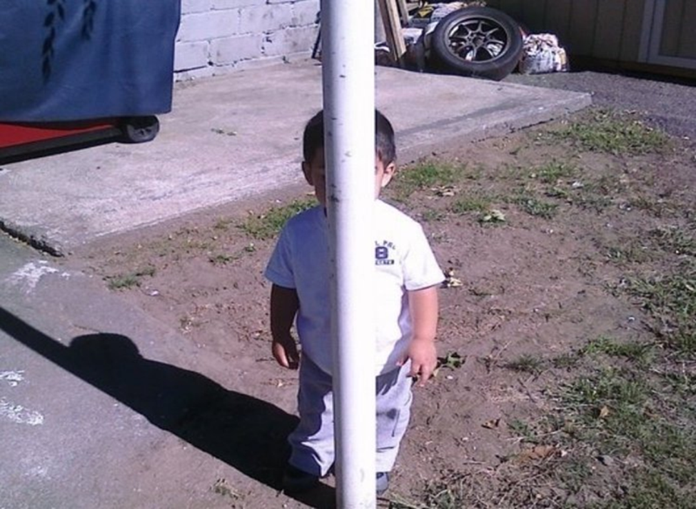
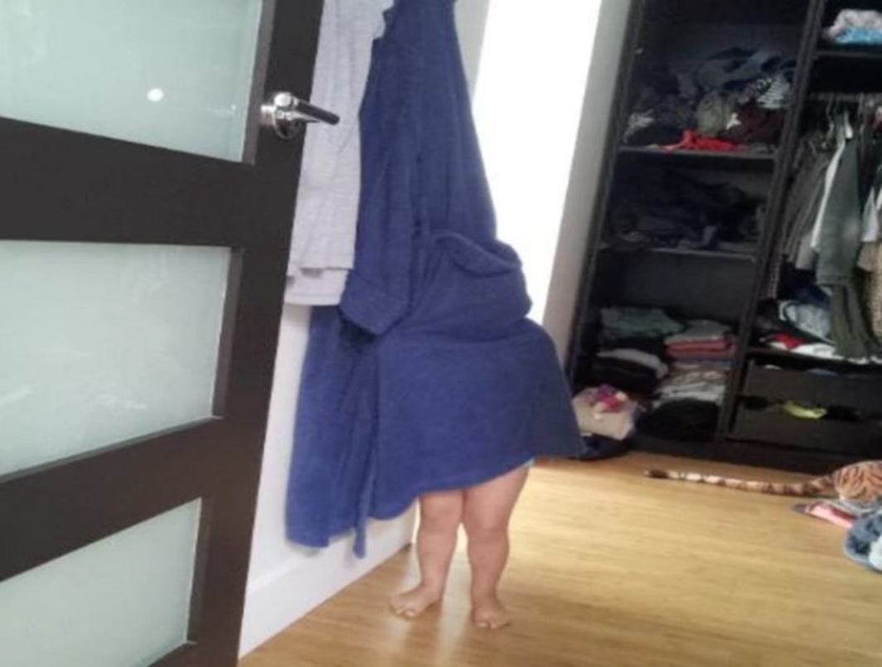
Remember playing Hide-n-Seek as a child?

Slide 5
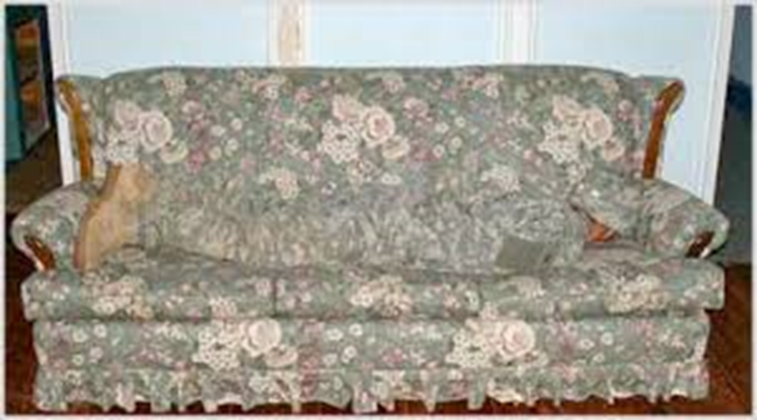
As we grow up, our ability to “hide” becomes a bit more sophisticated…

Slide 6

Quote of the Day
“Today feels like a great day to begin developing an addiction to drugs that becomes so destructive that I will risk my health, my family, my job, my future, my freedom and possibly even my life.”
- Quote by NO ONE

Slide 7

What we know…
Addiction is a complex disease.
Regular use of substances change the brain in ways that foster compulsive substance abuse.
Quitting is difficult, even for those who are ready to do so.

Slide 8

While the initial decision to use substances is often voluntary, the brain changes that occur over time challenge a person’s self control and ability to resist intense impulses.

Slide 9
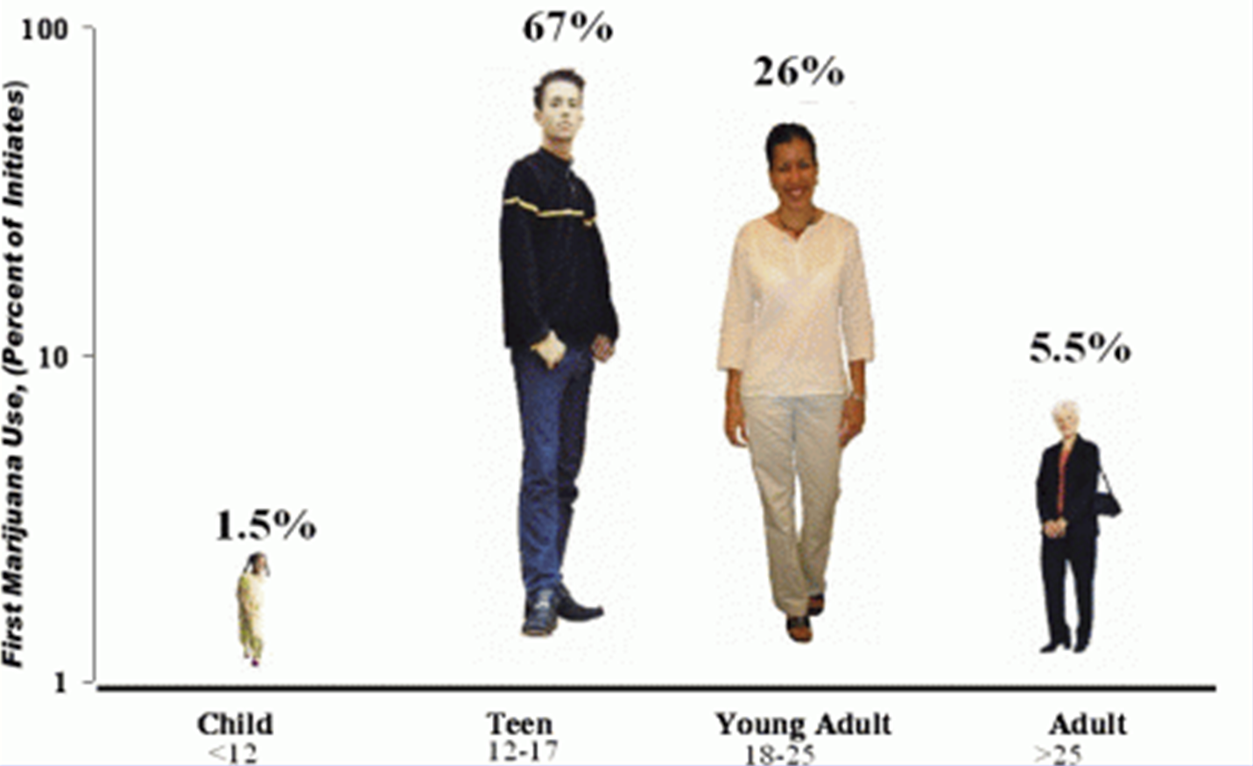
A Developmental Disease?
Addiction starts early…

Slide 10
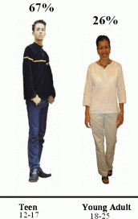
The Prefrontal Cortex:
A work in progress…
Generally not fully developed until age 24-25
Responsible for executive functioning:
  Planning
  Decision-Making
  Impulse Control
  Judgement
  Problem-Solving
  Short-term memory recall

Slide 11

Why is this important?
Consider the age range of the clients you serve…
Regardless of age, how would impairment to the pre-frontal cortex impact parenting?
  Planning
  Decision-Making
  Impulse Control
  Judgement
  Problem-Solving
  Short-term memory recall
Notes:
Interplay of substance use and child maltreatment

Slide 12

Environmental Stressors
Coerced use is not uncommon, and can lead to misuse and eventual dependency
  Relatives
  Friends
  Partners
  Pimps
Chronic Stress
  “Self-Medicating” Trauma
  Mental Health Disorders

Slide 13


In a study of 100 adult patients with poly drug abuse, 70% of the female and 56% of the male drug abusers had been sexually abused prior to the age of sixteen.
“Hope, not pain or consequence, is the critical ingredient to successful treatment and recovery of traumatized women.”
Notes:
Najavits et al. 1997
Najavits, L.M., Weiss, R.D., and Shaw, S.R. (1997) "The Link Between Substance Abuse and Posttraumatic Stress Disorder in Women: A Research Review." American Journal on Addictions, 6:273-283.
William White http://www.williamwhitepapers.com/blog/2015/02/from-trauma-to-transformative-recovery.html

Slide 14
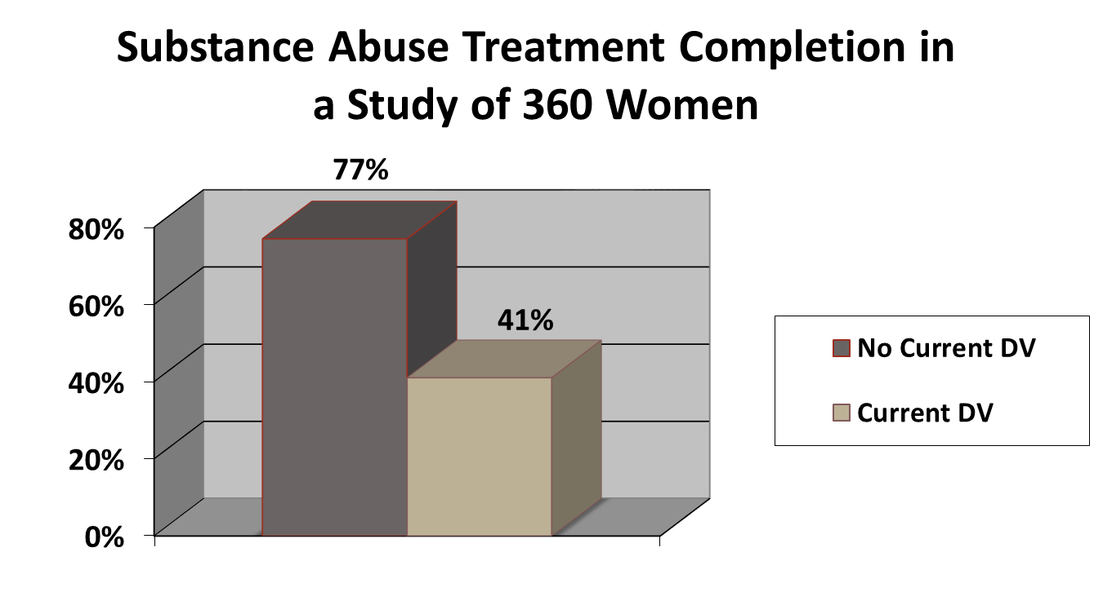
Domestic Violence Involvement
(Source: Violence in the Lives of Substance Abuse Treatment: Service and Policy Implications, 2000, p. 4)

Slide 15
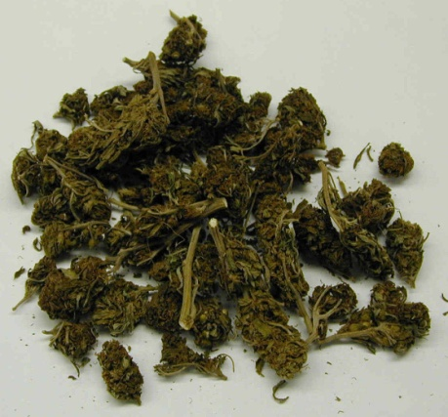
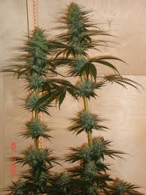

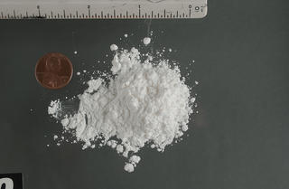
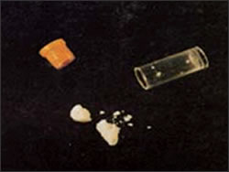
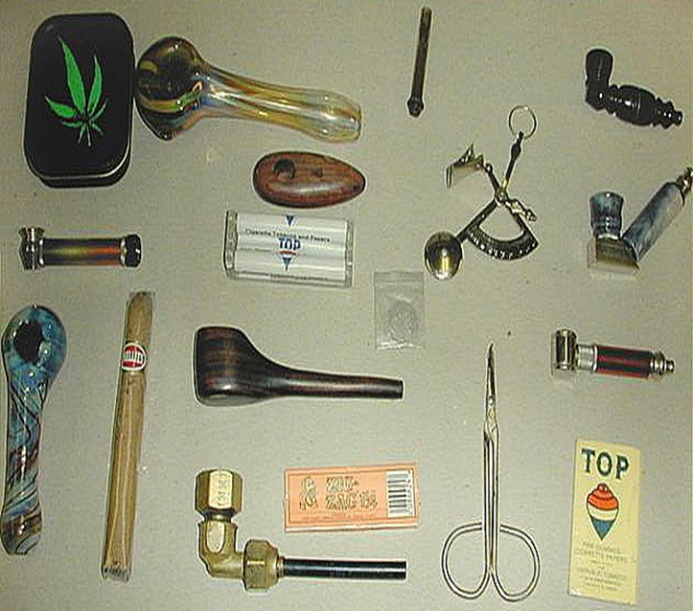
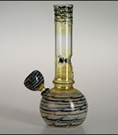
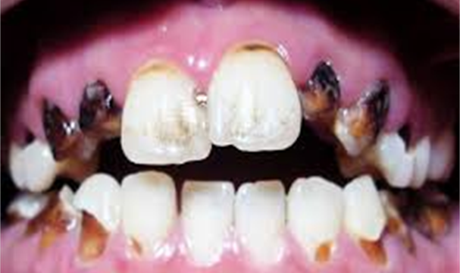
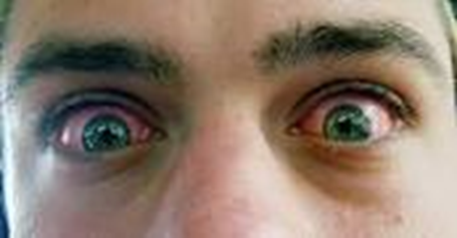
OBVIOUS SIGNS: Drugs
Obvious Signs of Drug Use…

Slide 16
Hidden Signs of Drug Use…
Detection may be more difficult when parental drug use is:
  Infrequent
  In the early stages before adverse physical, child caretaking, or environmental signs are obvious
  Less compulsive such as casual marijuana use
Chaotic Lifestyle:
  Dirty laundry/diapers; mattresses lacking sheets; no toilet paper; little to no food
  Televisions, appliances, video game stations, other electronics and items of value that suddenly disappear
  Utilities turned off; flashlights in various locations due to non-payment of power bills
  The presence of pornography, firearms, and other weapons
Notes:
Also behavioral signs…
No set meal times
No set bed times
No set homework structure
No age-appropriate chores
No curfew times
No consistent discipline style
Loss of family traditions

Slide 17
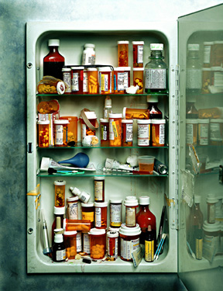
Prescriptions: Misuse?
In the case of prescription bottles, is the patient’s name the same as the parent or caretaker?
Are there multiple prescription bottles of the same drug spanning the same time period but from different doctors?
Are there multiple types of prescription drugs?
Notes:
Opioid Epidemic in Florida

Slide 18
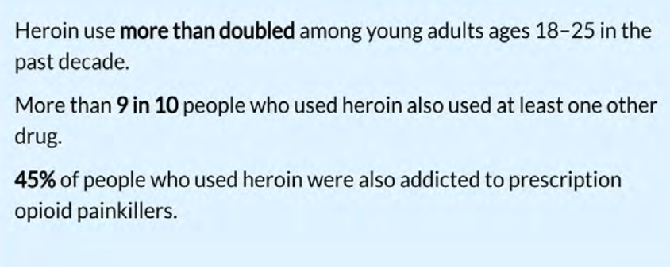
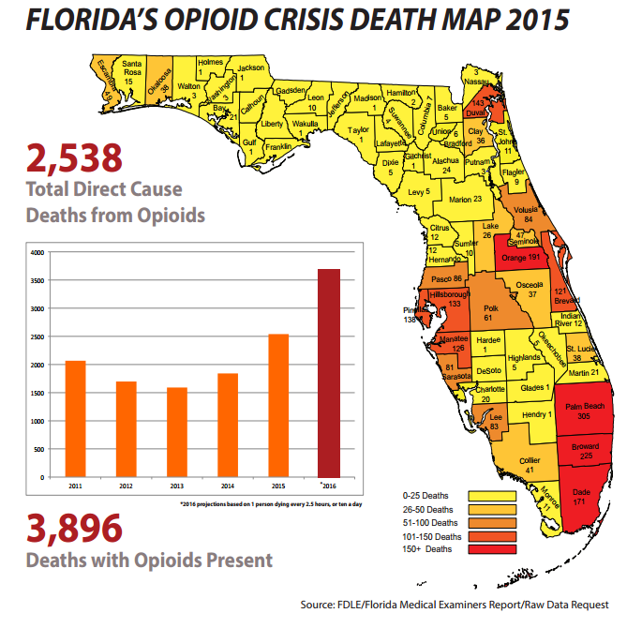
The Opioid Crisis
Source: CDC/Vital Signs/Heroine

Slide 19

Gentle Persistence:
Engaging and Retaining Substance-Involved Families
Notes:
Gentle Persistence: Move Slowly, Tread Carefully…

Slide 20
Patience: More than just a virtue…
Understand these families will be among the most difficult to engage and retain; be gentle, but persistent in efforts during outreach
In terms of recovery, the “Process of Change” is gradual and will take time, for both the participant and the home visitor
Expect secrecy, manipulation, drama, and resistance; its all part of the package
Remember what is going on “inside” the participant you are working with: Fear, Guilt, Shame, Anger, Depression, Frustration.
Try not to take anything personally. Separate the disease from the person…
Notes:
Chances are you’ve felt that way about something before… Remember how it feels to have those emotions stirred.
If you can’t empathize with the use, you can empathize with the feelings they are experiencing.

Slide 21

During the upward climb, keep your goals in mind…
What overall outcomes do we hope to see (even if the client can’t quite see them yet)?
Connection with a Family Specialist that can address their substance misuse or enrollment in a treatment program
Continued participation in the home visiting program
Progress on family’s goals
Improved outcomes for the children
To successfully engage and retain participants, we must meet the client where they are, and occasionally allow them to set the pace.
Notes:
Your chances of retaining the client go up dramatically as trust reaches a level where the secrecy dissolves and discussion begins.
MI skills come into play here.
Don’t go too far too fast.

Slide 22
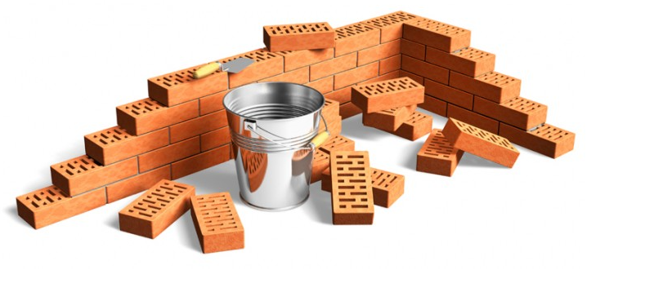
Laying the Groundwork: Establish Rapport
Until rapport is established, nothing else matters
Trust is essential to any hope of discussion or disclosure; trust takes time and must be earned
Focus on what the participant stands to gain from home visiting without immediately delving into substance use
Find and emphasize common points of interest that are neutral in nature: children, family life, challenges with work or school

Slide 23

Shape the Conversation…
Hardcore confrontations are ineffective and may result in client withdrawal from program
Approach any discussions that may relate to substance use in a non-threatening, non-judgmental manner
When asked for your thoughts, reflect your observations and concerns
The aftermath of a crisis may present a good time to begin steering the conversation toward more sensitive topics (once the dust has settled).
If not asked, but the time is right, NORMALIZE CONCEPTS and ASK PERMISSION to discuss sensitive topics.
Start with broad questions and gently steer toward more specifics

Slide 24
Example: Discussing Past Trauma
Q: How do you want to raise your children alike/different from what you experienced as a child?
Q: What had the most significant impact on your childhood?
NORMALIZE: “Children don’t come with an instruction manual . . .”
Q: May we talk about that?
Q: What are some healthy ways you dealt with that . . . Unhealthy?
ASKING PERMISSION
Notes:
NOTICE MOVING FROM GENERAL TO SPECIFIC
IMPORTANCE OF INDIRECT QUESTIONING PTSD AND ALL SUBSTANCE ABUSE EXPLORATION
TOO DIRECT = FROG

Slide 25
Example: Discussing Substance Use
Q: How do you relieve stress?
NORMALIZE: “Everyone gets overwhelmed from time to time . . .”
Q: Have there been times you’ve felt inclined to do that? Tell me about that.
NORMALIZE: “A lot of people have a few beers or find some other way to take a break.”
Q: May we talk more about how (alcohol/pot/drugs) helps you cope?
Q: In what ways has it been helpful? In what ways has it been unhelpful?
ASKING PERMISSION
Notes:
NOTICE MOVING FROM GENERAL TO SPECIFIC
IMPORTANCE OF INDIRECT QUESTIONING PTSD AND ALL SUBSTANCE ABUSE EXPLORATION
TOO DIRECT = FROG

Slide 26
Follow-up Discussions
Pave the Way to Progress
Take a break from the topic when the client begins to shut down or is overtly lying about substance use
Timing is everything – look for an opportunity to gently delve back into the topic during a later visit
Be on the lookout for potential challenges that could set the client back in their “process of change” and work toward addressing those challenges (domestic violence, unresolved trauma)
Begin tapping into and expanding the quality of their support systems, especially others living in the home

Slide 27
Example: Gauging support in the home
NORMALIZE:
“All couples argue . . .”
“Many people struggle with controlling their emotions/behavior . . .”
Q: How would you describe you/your partner?
Q: How can you tell when your partner is upset…angry…in a good mood…depressed?
ASKING PERMISSION
Q: Can we talk a bit more about the support you receive at home?
Q: How does your partner typically deal with emotional triggers?

Slide 28
Continuing Conversations should “EVOLVE” based on the participant’s STAGE OF CHANGE
Precontemplation
Contemplation
Preparation
Action
Maintenance

Slide 29

Supporting the Supporter:
The Supervisor’s Role

Slide 30
Supervisory Skills:
Supervisors should –
Understand that these families will be among the hardest to engage and retain – regardless of skill level
Have a general working knowledge of substance use disorders and the stages of change
Have a working knowledge of motivational interviewing techniques
Provide necessary resources to home visitors assigned to substance-involved families (additional supervision time, extra visits, etc.)
Be on the lookout for burnout and discouragement
Use reflective supervision

Slide 31

Reflective Supervision
Provides a safe, non-threatening atmosphere in which the worker can share information about their families as well as their own personal emotional reactions.
Develop critical thinking and confidence by asking open-ended questions that encourage the home visitor to arrive at their own conclusions
Allow the home visitor to “decompress” and process emotions when frustrated with the behavior of the participant.
Remind the worker not to take the participant’s words/actions personally
Model patience, a non-judgmental attitude, motivational interviewing techniques, and provide support – the same behaviors you want the worker to exhibit when working with participants.
Do for, do with, cheer on!

Slide 32
Questions?

